Slide 1
Dell Conversation Class
Christopher bAUMAN

Slide 2
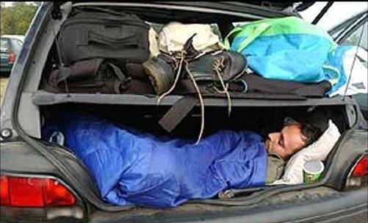
Education Infographic
Chris Bauman

